Slide 1
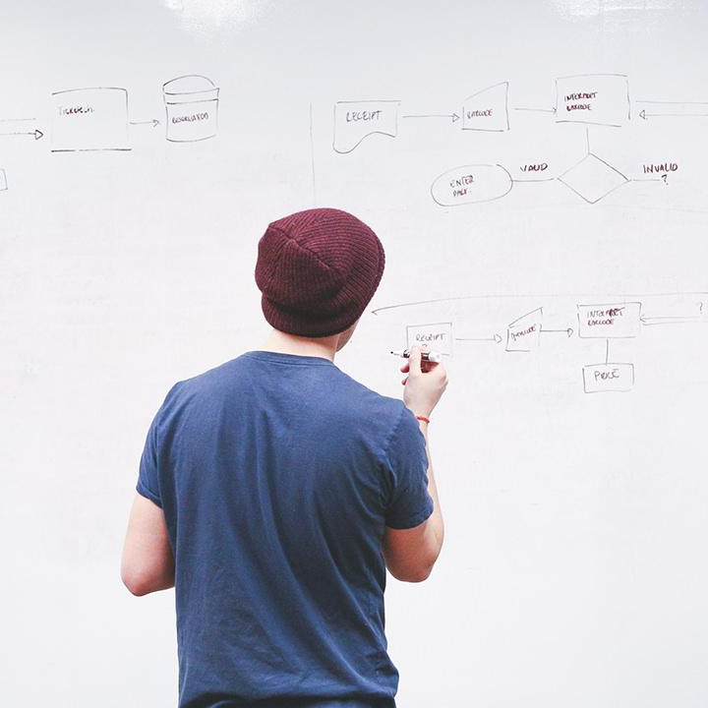
HELLO!
Here 1Crore Projects
I am here because I love to give presentations.
You can find me at @1CROREPROJECTS

Slide 2
Data Security With Third Party Admin In Cloud Storage

Slide 3

AIM OF PROJECT
The aim of the project is it provides us services beyond of our imagination, not only in the field of virtualization but it also facilitates in models like client/server deployment models.
.

Slide 4
ABSTRACT
Cloud is now tremendously growing technology in market. It provides us services beyond of our imagination, not only in the field of virtualization but it also facilitates in models like client/server deployment models. It provides advantage of distributed computing, grid computing, utility computing, autonomic computing, as well as various services like web services and software services.

Slide 5
INTRODUCTION
Cloud computing is a virtual environment providing IT services on low coat and using third party access for it. Various researchers describe cloud differently like Zhiguo Wan et. al. states that “Cloud Computing is a new computing paradigm that is built on virtualization, distributed computing, utility computing and service oriented architecture”. This can reduce complexity, Hardware requirement and client side requirements. So, it is very popular and can handle massive amount of data.

Slide 6
EXISTING SYSTEM
TPA is supposed to be a central, independent & reliable component; it may become bottleneck to the entire system.
Any unusual activity in TPA may cause entire cloud system to go down or reduction in the performance.
Cloud data owner can directly control the cryptographic operations to be performed on his data stored on cloud. Cloud

Slide 7
DISADVANTAGES
1. You Need an Internet Connection
2. Extra Storage Space Comes at a Cost
3. Security and Privacy Concerns With Some Providers

Slide 8
PROPOSED SYSTEM
The proposed system supports real-time, multiple-terminal, and cloud-independent storage synchronization. We also prototyped the proposed system.
We then use the idea of state encoding and a push-pull paradigm to propose a cloud object storage synchronization system.

Slide 9
ADVANTAGES
1.Data Redundancy and Replication
2.Data Tiering for Cost Savings
3.Usability or Accessibility
4. Ransomware/Malware Protection

Slide 10





SYSTEM ARCHITECTURE
Register
Send key
Authorized the TPA after login
Download the file in decrypted format
Upload the file in encrypted format

Slide 11
MODULES
In this project has five modules:
1. Data user
2. TPA
3. KGC
4. Cloud Server
5. Attacker

Slide 12
DATA USER
Register their own details.
Authorized the TPA After login, Login their correct user name and password.
Upload the files to the cloud in encrypted format with file private and trapdoor key by using fuzzy logic for key generation for encryption & decryption.
Manage the file.
Search Files: User can search file with Encrypted format, then sends the request to the key Generator Center.
View Request Status Waiting or Accept.
Download Files by using the file private key, user can download the files in decrypted format.
Logout

Slide 13
TPA
Login the account with the correct credentials
Student can view all the three semester mark details
Like subject, mark, Pass/fail
Logout

Slide 14
ATTACKER:
Login
View all Upload file & Attacker them.
Logout

Slide 15
HARDWARE REQUIREMENTS
System : Pentium IV 2.4 GHz.
Hard Disk : 40 GB.
Floppy Drive : 1.44 Mb.
Monitor : 15 VGA Colour.
Mouse : Logitech.
Ram : 512 Mb.

Slide 16
SOFTWARE REQUIREMENTS
Operating system : Windows XP.
Coding Language : JAVA
Data Base : MYSQL

Slide 17
FUTURE WORK
For this project, a privacy-preserving guarantee that reveals nothing but the d common attributes chosen by cloud server when executing the auditing protocols. The authors are investigating a strong privacy-preserving mechanism that can ensure zero-knowledge in the auditing phase. Future work includes proposing a concrete construction that are both practical and with high efficiency.

Slide 18
CONCLUSION
we proposed an attribute-based cloud data integrity auditing protocol, for the first time, to simplify the key management issue in traditional cloud data auditing schemes. We formalize the system model and security model for this new primitive. Subsequently, a concrete construction is presented by involving the idea of attribute-based cryptography.

Slide 19
REFERENCE
H. He, H. Wang, J. Yang, P.S. Yu, “BLINKS: ranked keyword searches on graphs,” Proc. of the 2007 ACM SIGMOD international Conf. on Management of data, Beijing, China, pp. 305-316, 2007.
C.-S. Park, S. Lim, “Efficient processing of keyword queries over graph databases for finding effective answers,” Information Processing & Management, vol. 51, no. 1, pp. 42-57, 2015.

Slide 20
THANKS!
Any questions?
You can find me at
Reach us – 1croreprojects@gmail.com
Contact / Whatsapp: 7708 150 152 / 9751 800 789 / 790 432 0834

